Slide 1
بِسْمِ اللهِ الرَّحْمٰنِ الرَّحِيْمِ

Slide 2
Final year presentation on Web-Base Application “Blood bank Management System”
Department of computer science,
Program (Information Technology & Software Engineering)
Karakoram international University, Gilgit

Slide 3
PRESENTED BY: Adnan Ali Shah(2020-KIU-BS2070) Wajid Ali(2020-KIU-BS2064) FINAL YEAR PROJECT COMMITTEE DEPARTMENT OF COMPUTER SCIENCE Supervised By: Dr. Gul Sahar

Slide 4

Streamlining Blood Bank Operations
Our project aims to revolutionize blood bank management,
addressing the critical need for safe and sufficient blood
supplies in healthcare. By leveraging an online platform,
we strive to reduce human error, improve data accuracy,
and ensure timely blood availability during emergencies.

Slide 5
Challenges in Blood Bank Management
Manual Errors
Hospitals and blood banks face challenges like manual errors, delayed responses, and miscommunication in managing donations and transfusions.
Lack of Real-Time Data
The absence of a centralized system for tracking blood inventory in real-time leads to the risk of using expired or incompatible blood.
Need for Integration
There is a need for a secure, integrated system to improve operational efficiency and patient outcomes in blood bank management.

Slide 6
Existing Blood Bank Systems
Manual Systems
Automated Systems
Our Approach
Traditional blood bank systems rely on manual processes, leading to errors and delays in managing donations and transfusions.
Existing automated systems provide real-time updates but lack comprehensive features for donor management and transfusion requests.
Our project builds on and improves existing approaches with enhanced features like donor management, blood inventory tracking, and transfusion request handling.

Slide 7

Project Objectives
Automate Processes
Real-Time Inventory
1
Automate blood bank processes to reduce human error and improve efficiency.
2
Enable real-time access to blood inventory for hospitals and blood banks.
Enhance Communication
Ensure Blood Safety
3
Improve communication between blood banks and healthcare providers.
4
Enhance data accuracy and track expiry dates and compatibility to ensure blood safety.

Slide 8
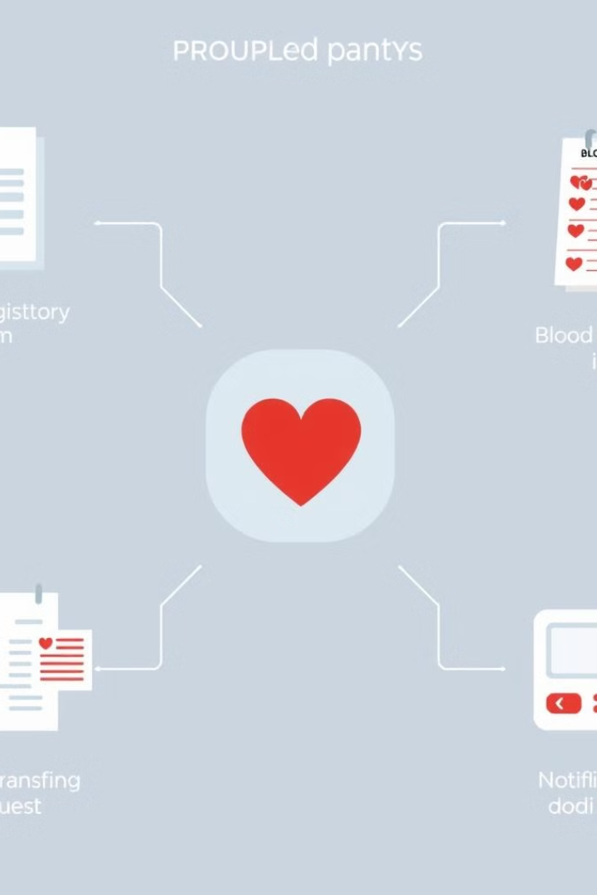




Key Features
Donor Management
Streamlined donor registration and scheduling.
Inventory Tracking
Real-time monitoring of blood stock levels and expiry dates.
Transfusion Requests
Efficient handling of blood transfusion requests from hospitals.
Notifications
Alerts for critical events, such as low blood supply or expiring
inventory.

Slide 9
Testing and Evaluation
Testing Phases
Test Results
System Performance
Unit testing, integration testing, and user acceptance testing (UAT).
Identified and addressed errors, performance issues, and user feedback.
Demonstrated responsiveness, accuracy, and ease of use.

Slide 10

System Limitations
Scalability
Budget and Time
Future Improvements
Potential constraints in handling larger-scale operations in larger hospitals or regions.
Certain features or enhancements may be limited by available resources.
Plans to add new features and enhance real-time synchronization in future iterations.

Slide 11
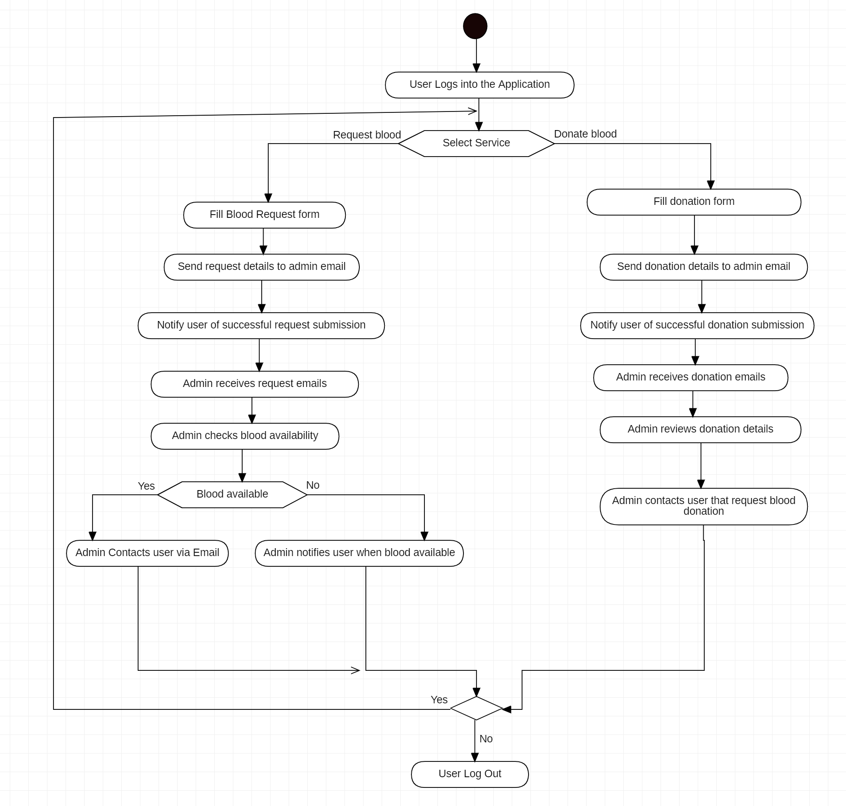
Process flow chart

Slide 12
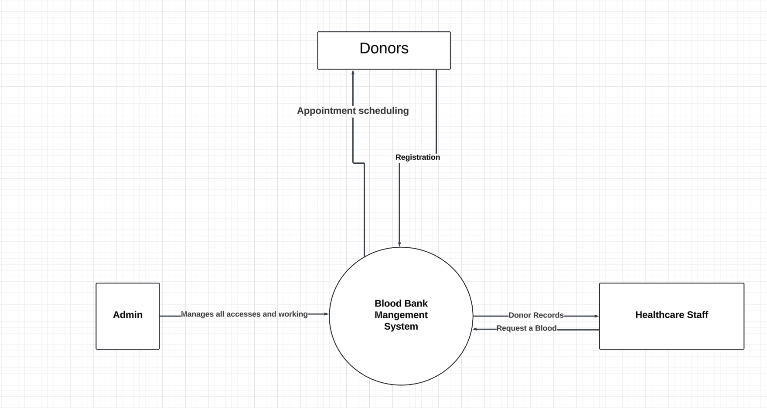
Data flow diagram(dfd)

Slide 13
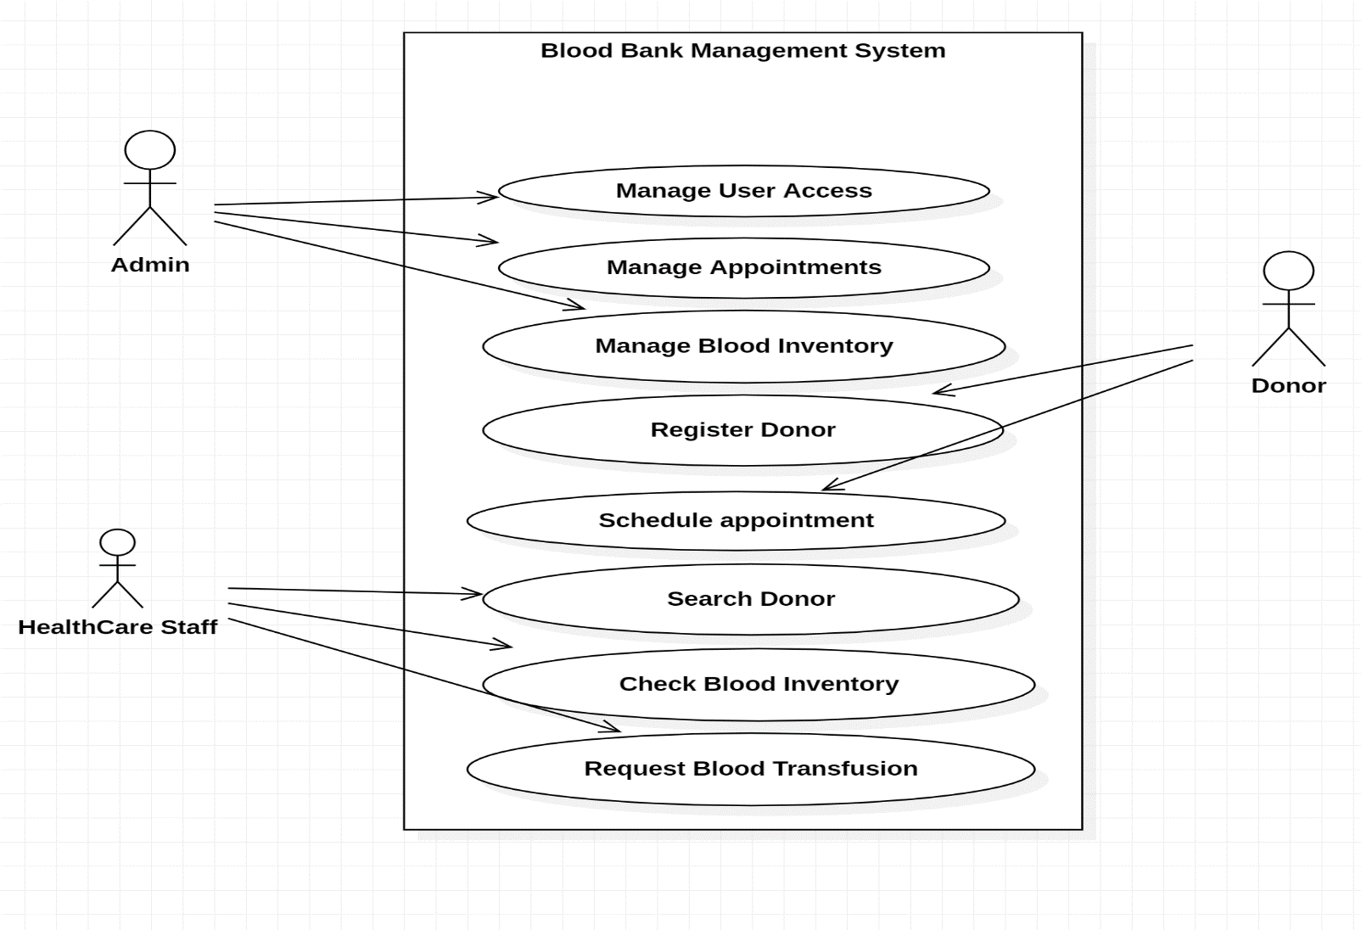
Use case

Slide 14
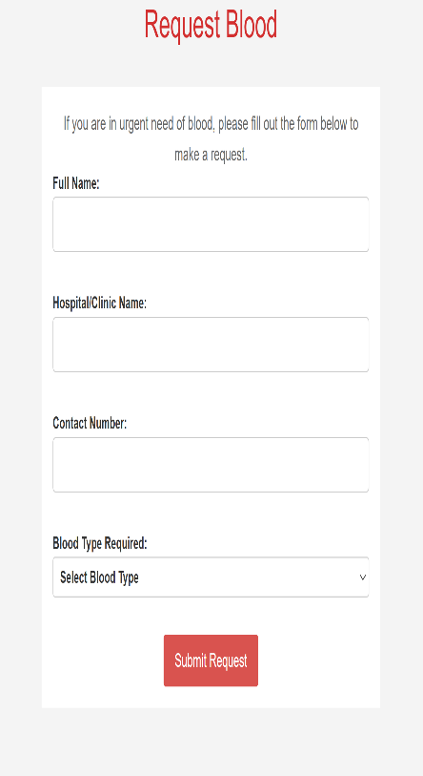
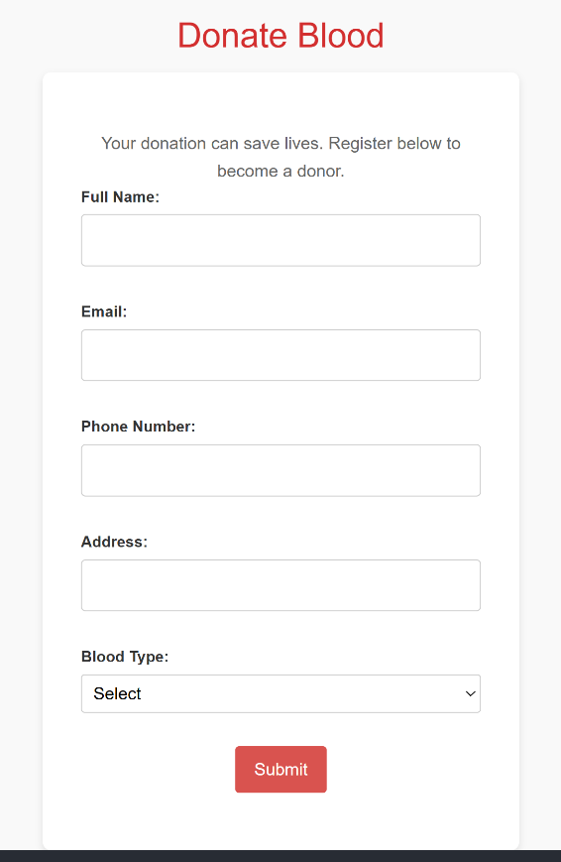
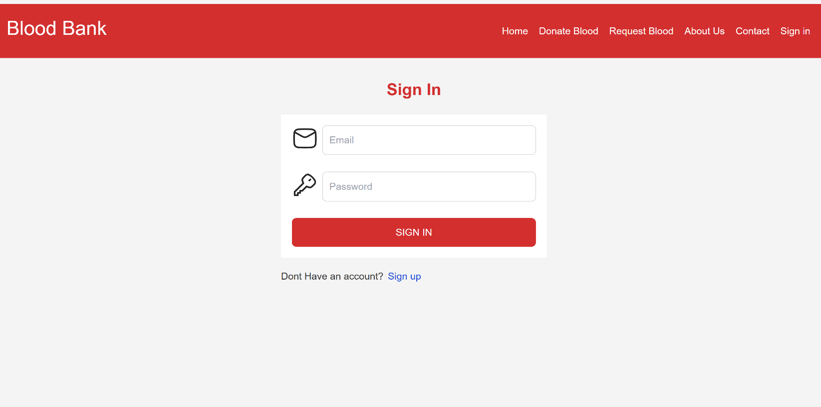
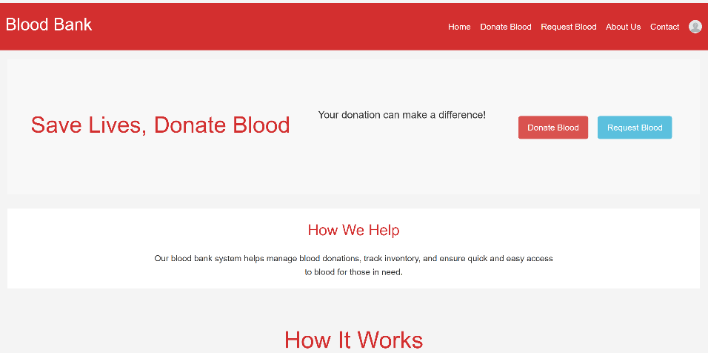
Ui interface

Slide 15

Conclusion and Future Work
Our blood bank management system has successfully addressed the challenges of traditional blood bank operations, streamlining processes and improving patient care. Looking ahead, we aim to integrate the system with other healthcare systems, explore advanced security measures, and expand its capabilities to support larger-scale operations.

